Slide 1
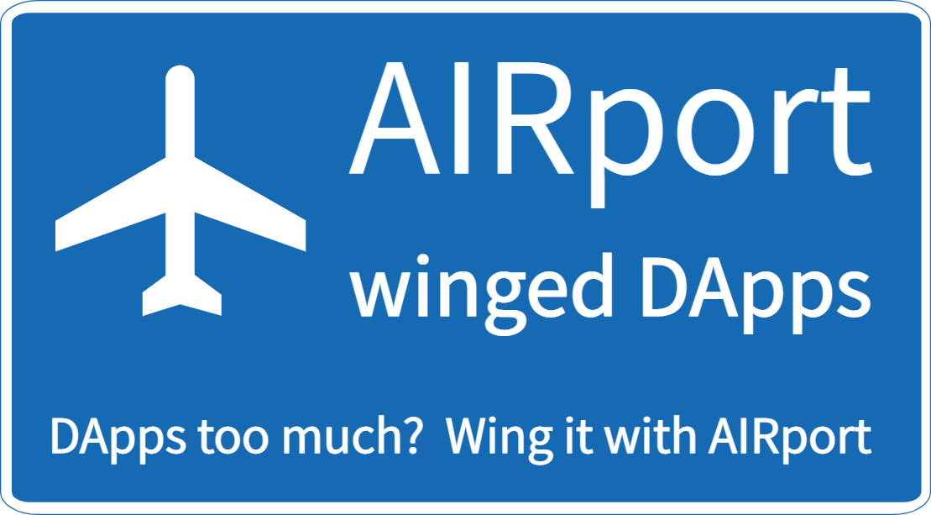
Decentralized Relational Database on Arweave
Artem Shamsutdinov

Slide 2
History
Wrote Family Organizer app in 2015
Centralized server was required - not acceptable for families to give up data
Started writing AIRport in 2016 with a very small scope
Kept evolving until it reached multi-App phase

Slide 3
Summary
Why have a database framework?
How?
Developers like RDBMSs
Users share data
Apps share data – cross App synergies
New apps access existing data
Hybrid decentralized/centralized applications
Virtual Repositories
Database on each end-user device

Slide 4
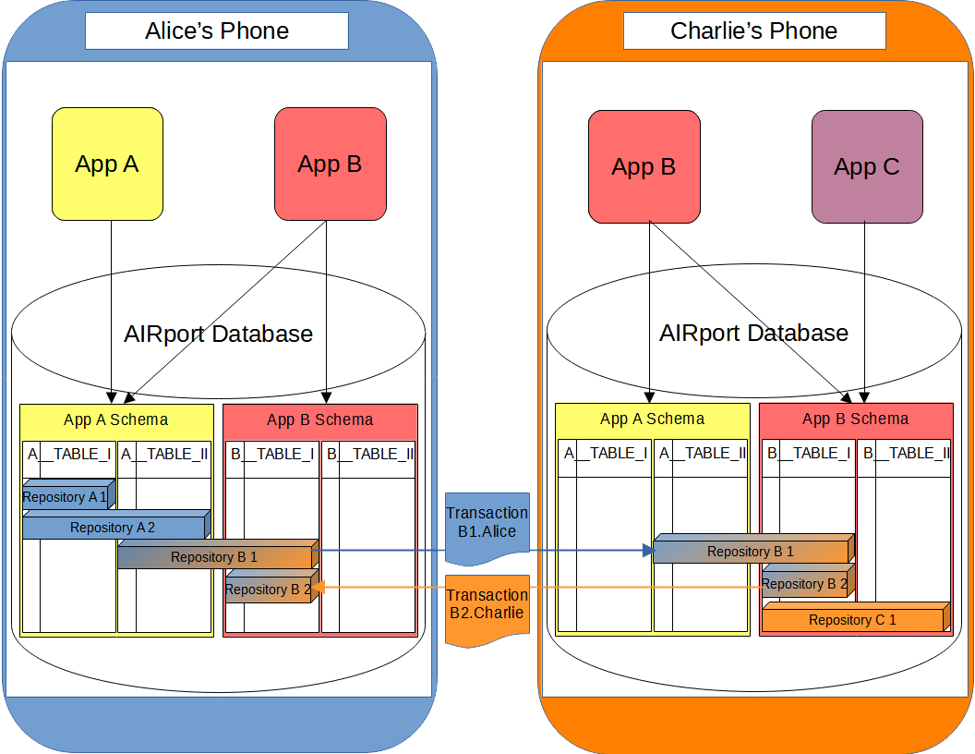

Slide 5
App collaboration & data reuse
User control their data – per repository
Apps are in control of sharing schemas with other applications
Promotes small complementary Apps

Slide 6
Economics - incentives
App Users – keep data private, remove per-App data duplication, profit sharing
App Creators – profits from apps, focus on apps not framework
AIRport – attract App developers to platform

Slide 7
Economics - Monetization
Decentralized Ads – “advertisement is an engine of progress”
Ads aren’t bad (albeit annoying) if data is kept private
Fee model – opt out of Ads
Profit sharing – all 3 parties get a cut of Ad revenue

Slide 8
DeveloPER ProDUCTIVITY FOCUS
Well known relational database standard
Decorator/Annotation based ORM
“Better than Graph QL” – interlinked object graph retrieval
Declarative, nested validation rules
Shared schema and app logic code, running in V8 isolates
Observable data

